Slide 1

Data Policies and Practices AGU Publications Models and Model Output 3 August 2020
Brooks Hanson
AGU Executive Vice President
bhanson@agu.org
https://orcid.org/0000-0001-6230-7145

Slide 2
Open Access/Open Data Initiatives
Two RFI’s this year from US OSTP
Request for Information: Public Access to Peer-Reviewed Scholarly Publications, Data and Code Resulting From Federally Funded Research
Request for Public Comment on Draft Desirable Characteristics of Repositories for Managing and Sharing Data Resulting From Federally Funded Research
https://www.whitehouse.gov/ostp/legal/
Preprint guidance from ASAPbio including on data. Encourages data availability statements and declarations (are data available (yes/no)

Slide 3
AGU’s position statement on data affirms that
“Earth and space science data are a world heritage, and an essential part of the science ecosystem. All players in the science ecosystem—researchers, repositories, publishers, funders, institutions, etc.—should work to ensure that relevant scientific evidence is processed, shared, and used ethically, and is available, preserved, documented, and fairly credited.”
Data and other research artefacts, such as physical samples, software, models, methods, and algorithms, are all part of the science ecosystem and essential for research
https://www.agu.org/Share-and-Advocate/Share/Policymakers/Position-Statements/Position_Data
Notes:
To achieve this legacy, all AGU members and stakeholders must have a clear understanding of the culture of responsible research, and take action to support, enable, and nurture that culture.
Championing Open and Transparent Data
Enabling a Robust Science Ecosystem
Creating Effective Culture Change

Slide 4


STM 2020 Research Data Year
Share – Link – Cite
Working with publishers and other partners to boost effective sharing of research data:
SHARE:
Increase the number of journals with data policies and articles with Data Availability Statements (DAS)
LINK:
Increase the number of journals that deposit the data links to the SCHOLIX framework
CITE:
Increase the citations to datasets along the Joint Declaration of Data Citation Principles
https://scholarlykitchen.sspnet.org/2018/12/12/making-magic-happen-implementing-and-contributing-data-citations-in-support-of-todays-scholarship/
https://www.stm-researchdata.org
Notes:
AGU is on the Steering Committee

Slide 5
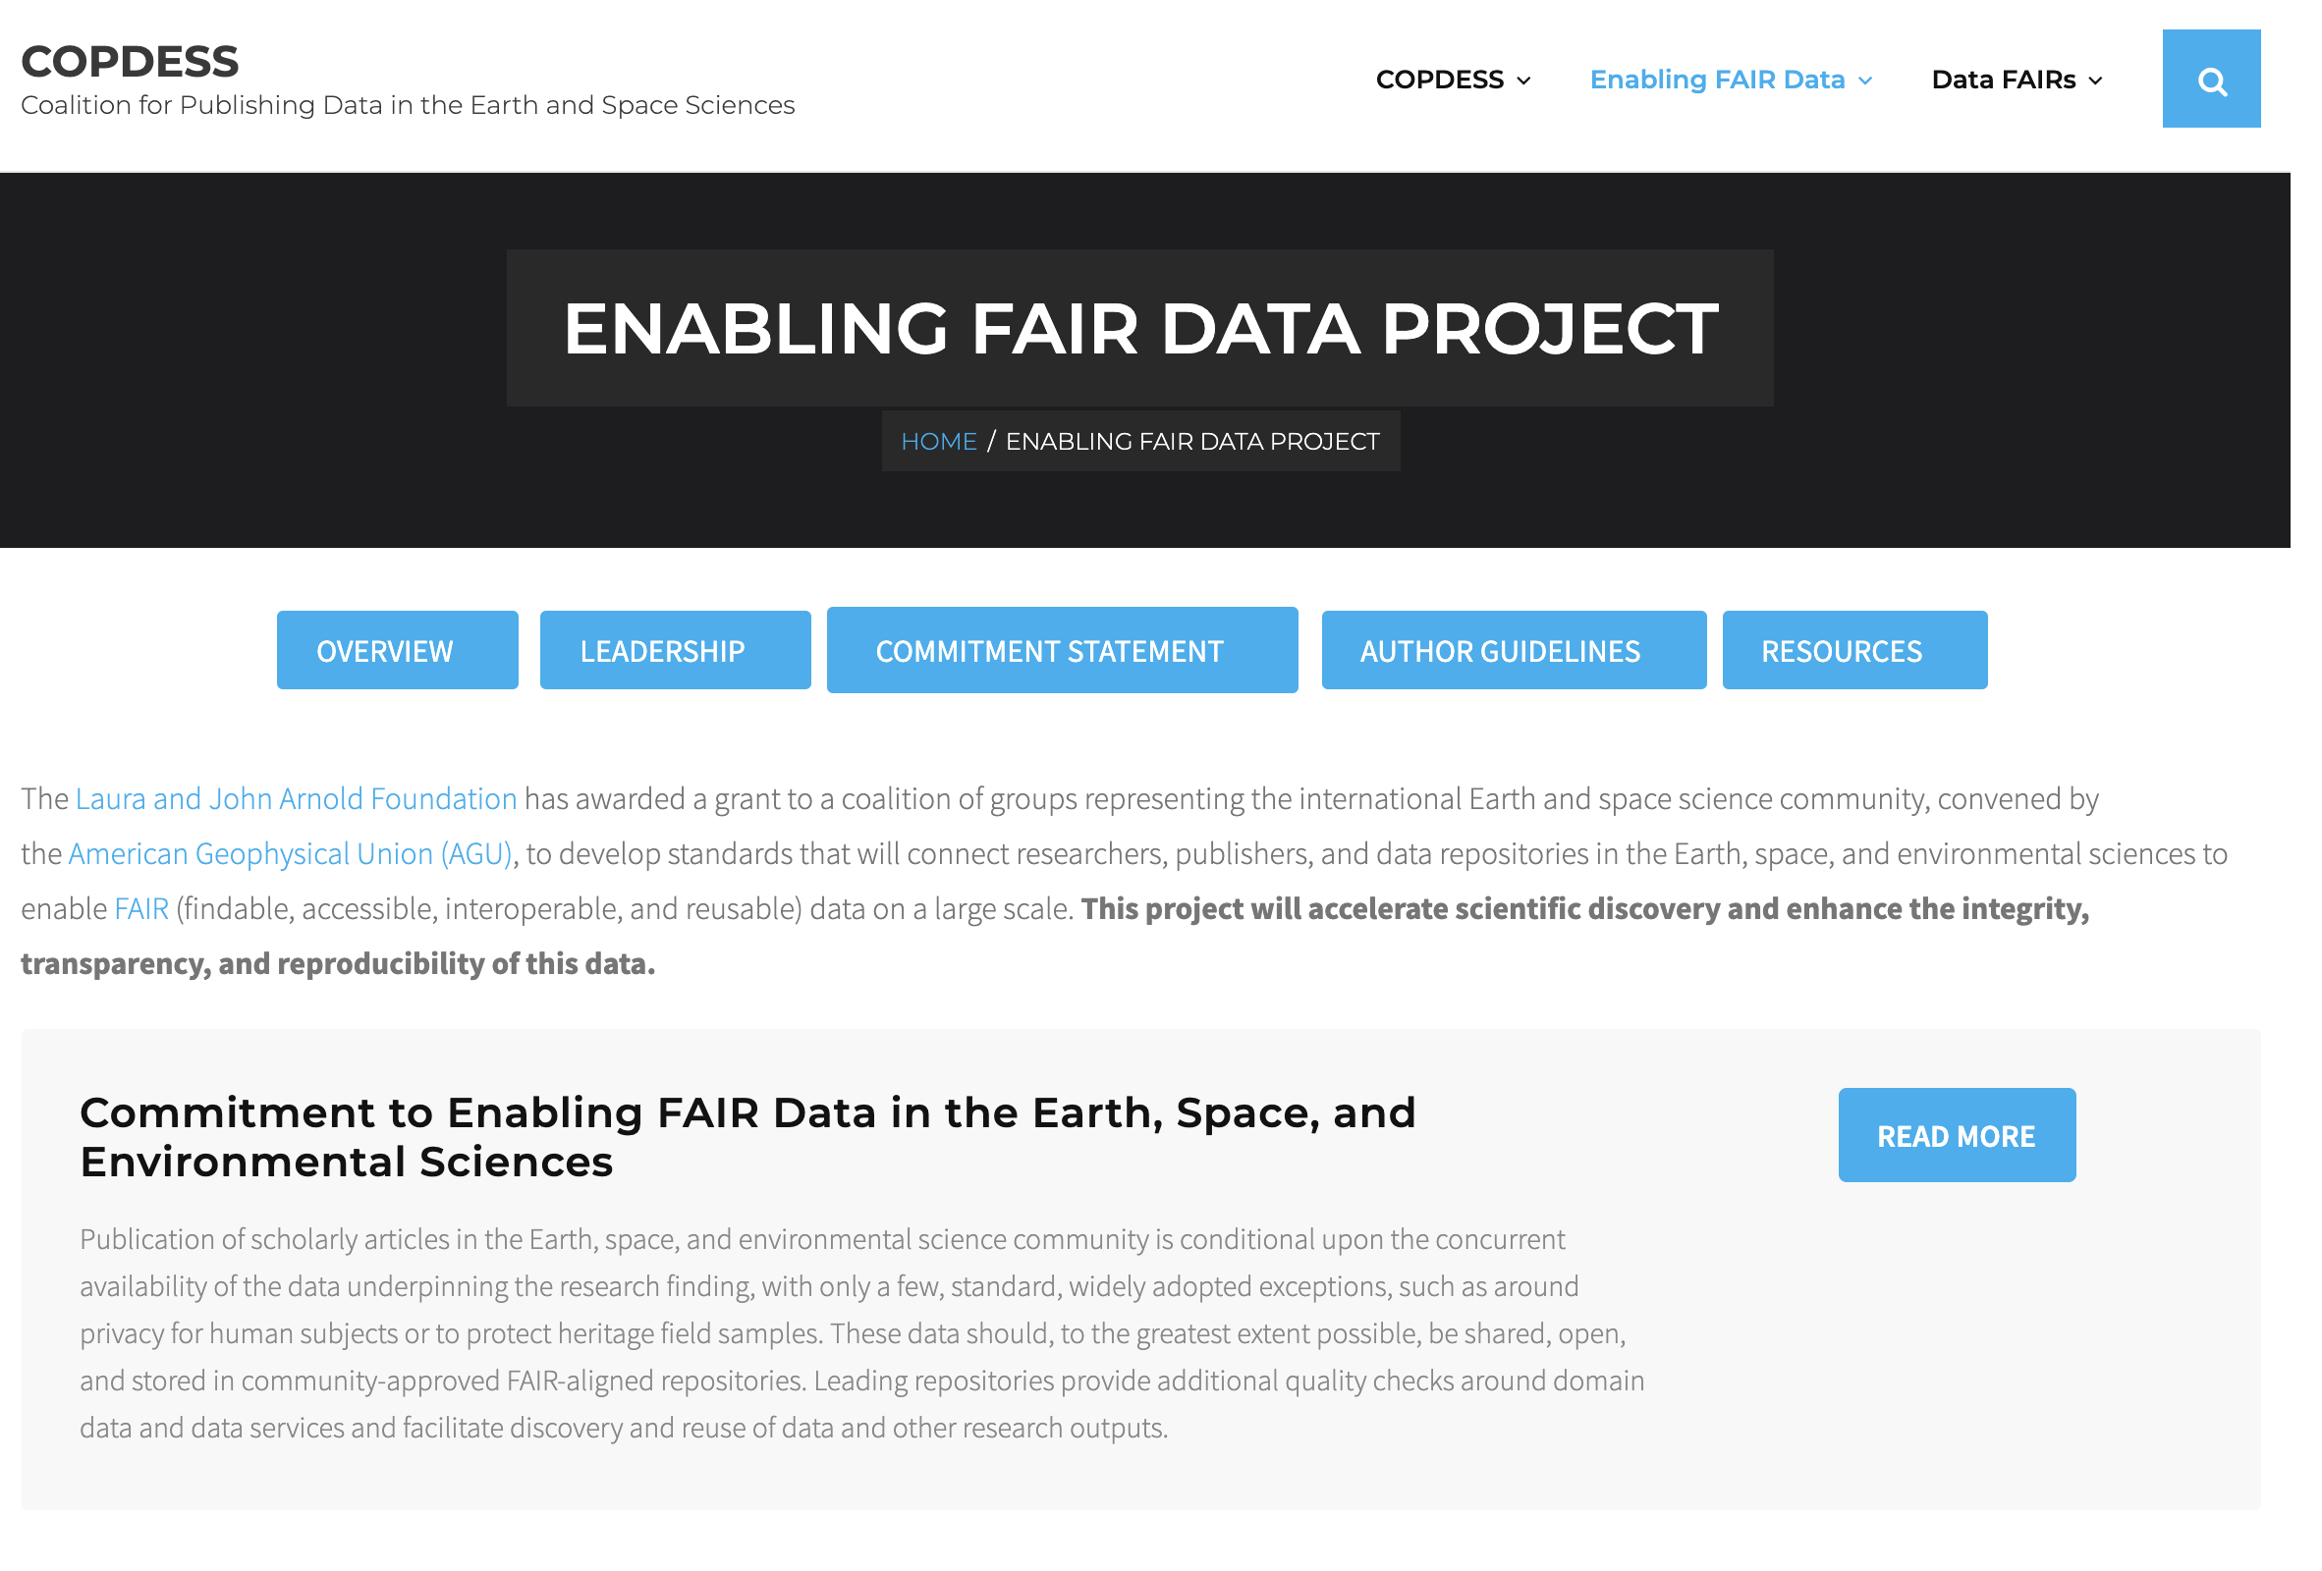

Slide 6
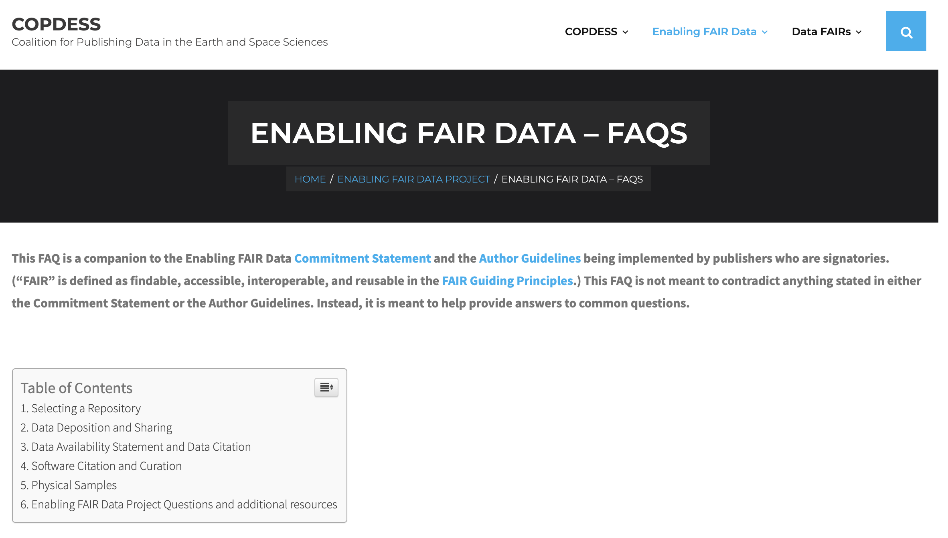
Q 2.9. My data are mostly model output or are derived summary figures based on numerous model runs and outputs. The collective output could easily exceed 1 TB. What am I required to deposit?
A. Please see section 3 below on how to cite and deposit software. If you are part of a modeling center that has a standard archiving plan for models and run output, please follow that plan (such centers are an acceptable repository). In general, the most important information to provide on models is the code (and version used) and unique configurations, any input parameters, run files, and a description of the overall run environment and parameter space tested. Representative output can also be deposited, ideally key data that form the figures included in the paper.

Slide 7
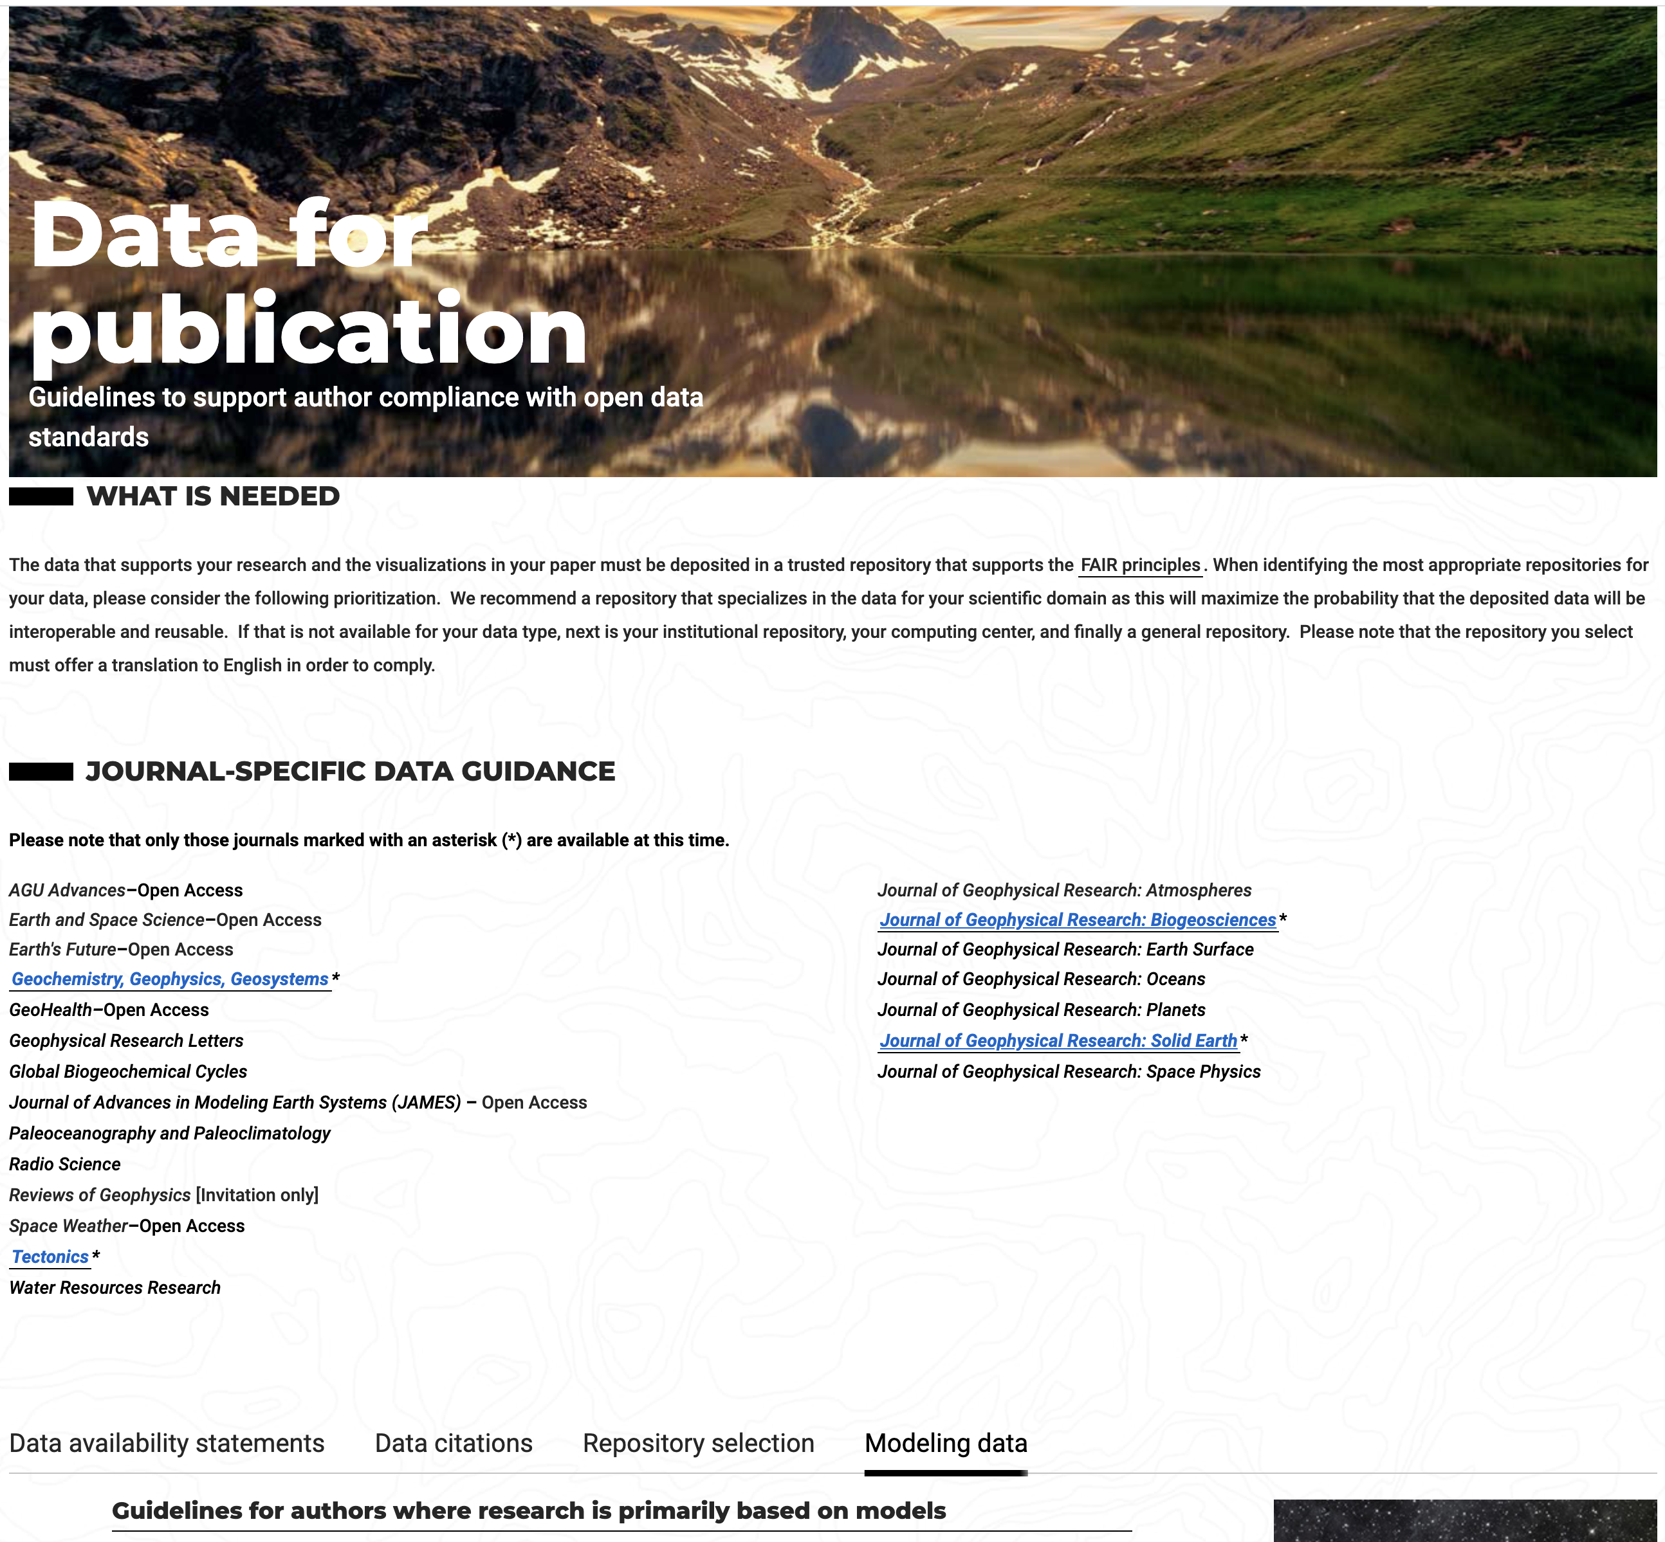
https://www.agu.org/Publish-with-AGU/Publish/Author-Resources/Data-for-Authors
Separate Data Availability Statements Now Required (not part of acknowledgments)
Data Citations Required; Software/model citations encouraged

Slide 8
Guidelines for authors where research is primarily based on models
When the primary data for the research comes from model simulations, follow these guidelines:
Citation of the model.
BEST OPTION: Cite the model using a software repository that registers the version used for the paper with a globally resolvable persistent identifiers (e.g. Digital Object Identifier) and metadata that describes the model using community standards.
GOOD OPTION: Cite the model, including the version information, using a general repository (e.g. Zenodo option for GitHub). The repository entry should include along with the model 1) a descriptive file (e.g. metadata) that preferably follows a standard appropriate for your community, 2) a preferred citation that accurately captures the authors/creators of the model.
ACCEPTABLE OPTION: Cite the publication where the model is described with information about the version used for this paper.
Description of the model.
Include a description of the model in the text of the paper that is adequate to support reproducibility.
Information about the configuration/parameters used to run the model.
This information should be included in the paper text as well as providing the script used. The scripted should be cited, and preserved in a trusted repository. Any forcing datasets used should be described and cited.
Data that Supports the Summary Results, Tables, and Figures.
BEST OPTION: Cite a package in an appropriate repository that includes scripts, provenance information, and summary files that support the research, figures, and tables, consistent with archives maintained for transparency and traceability by assessments such as the IPCC.
GOOD OPTION: Cite files (e.g. scripts, descriptive detail) in an appropriate repository that support evaluating the research and provide the details behind the tables and figures.
ACCEPTABLE OPTION: Provide the necessary information for transparency and traceability of the analysis using your community standards or guidance.
Model Output Data (optional).
If certain model output data are instrumental to evaluating the research, then deposit these in a trusted repository (see ***) that supports the FAIR Data Principles. There are currently limited resources for preserving many files of large size. Selecting representative output from one or a few model runs as is recommended by a specific community may be necessary. If the model is not open because of the sensitivity of the research or proprietary concerns, then provide as much information as possible to support evaluation of the research and reproducibility.

Slide 9
Some challenges/issues
Proprietary software – Can still cite if appropriate and indicate in data availability statement how other researchers can obtain (pay for it is OK).
Representative model output still valuable for validation
Model data/output—Guidance from community(ies) is very important
Reproducibility can be hard/impossible
Packages (Jupyter; Code Ocean)—good for transparency and reproducibility but not good for curation. Data and software should still be in domain or appropriate repositories

Slide 10
FORCE11 – Software Citation Implementation Group
Journal Task Force Goals
In final internal review
Define common author guidelines for software citation
Explore developing best practices:
identify software citation,
identify relationship (supplemented, referenced),
copyediting,
maintain content through the process
Promote culture change around recognizing the importance of software via software citation
Consider defining features and tiers or levels of implementation of software citation
Recently started
Current publisher participants: AGU, IEEE, AMS, PLOS, AAS, OUP, Science/AAAS, Wiley, Nature, Elsevier
Infrastructure and Repository participants: Crossref, DataCite, representative of IPCC software repository, NCAR
Co-chairs: Daniel S. Katz (University of Illinois), Neil Chue Hong (Software Sustainability Institute / University of Edinburgh)
Notes:
Resources
See https://datacite.org/cite-your-data.html for data
See Software Citation Checklist for Authors v0.9 document
See Software Citation Checklist for Developers v0.9 document
See Software Citation Checklist for Reviewers document under review
See https://www.esipfed.org/esip-outputs-list/software-citation-guidelines from ESIP that provides domain specific examples of software citation and the reasons why the community should cite software.
RDA for data policy standards for journals and publishers: Hrynaszkiewicz, Iain; Simons, Natasha; Hussain, Azhar; Goudie, Simon (2019): Developing a research data policy framework for all journals and publishers. figshare. Preprint. https://doi.org/10.6084/m9.figshare.8223365.v1

Slide 11
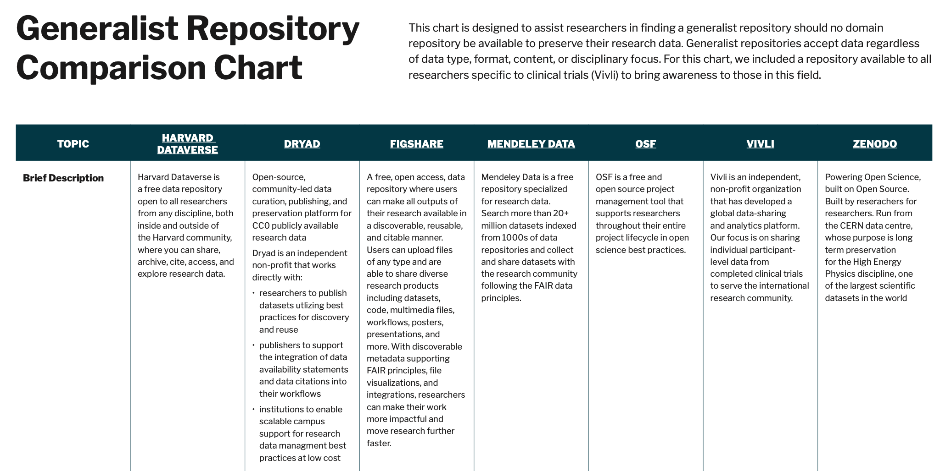
General Repository Comparison Chart
Outcome of the recent NIH Workshop
Notes:
Will be dynamic – hosted on FAIRSharing.org
RDA Community stood up to support.
Further session at RDA plenary on supporting better reuse of data stored in general repositories.
DOI: pending.

Slide 12
Sharing Resources – Near Future
Enabling FAIR Data FAQ updates
Society Community, collaborative working sessions planned
AGU Section webinars on data and software to include section leadership, related journal editors, related repositories

Slide 13
Thank you
Brooks Hanson
AGU Executive Vice President
bhanson@agu.org
https://orcid.org/0000-0001-6230-7145

